Slide 1

Agri-Mart
Presented by
Anurag Singh & Kavish Dhirawat

Slide 2
INDEX
INTRODUCTION
ARCHITECTURE
TECHNOLOGY PLATFORM USED FOR PROJECT
USERS ROLES AND RESPONSIBILITIES
USE CASE DIAGRAM FOR EACH USER
FUTURE SCOPE
SCREENSHOTS
CONCLUSION

Slide 3
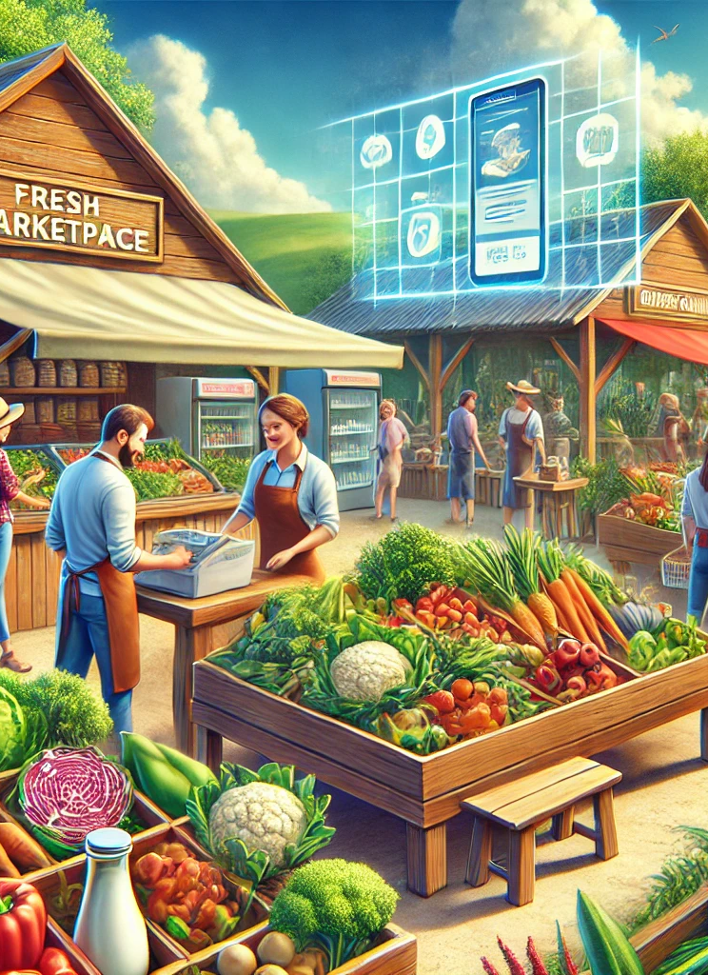
INTRODUCTION
The Agri-Mart connects farmers directly with customers, eliminating middlemen to ensure fresh produce at affordable prices. This platform empowers farmers by giving them direct access to buyers while offering consumers fresh, organic options conveniently.
The fresh produce industry is evolving with technological advancements like e-commerce, vertical farming, and robotics. Our system embraces these innovations, providing a seamless online shopping experience for fresh food.
Customers can browse a variety of farm products, add items to their cart, and check out with ease. Upon purchase, they receive an order confirmation via email, and their groceries are delivered straight to their doorstep.
This hassle-free solution saves time and effort—no more store-hopping or worrying about food quality. With just one click, users can access fresh, organic produce anytime, anywhere, making healthy eating more accessible than ever.

Slide 4
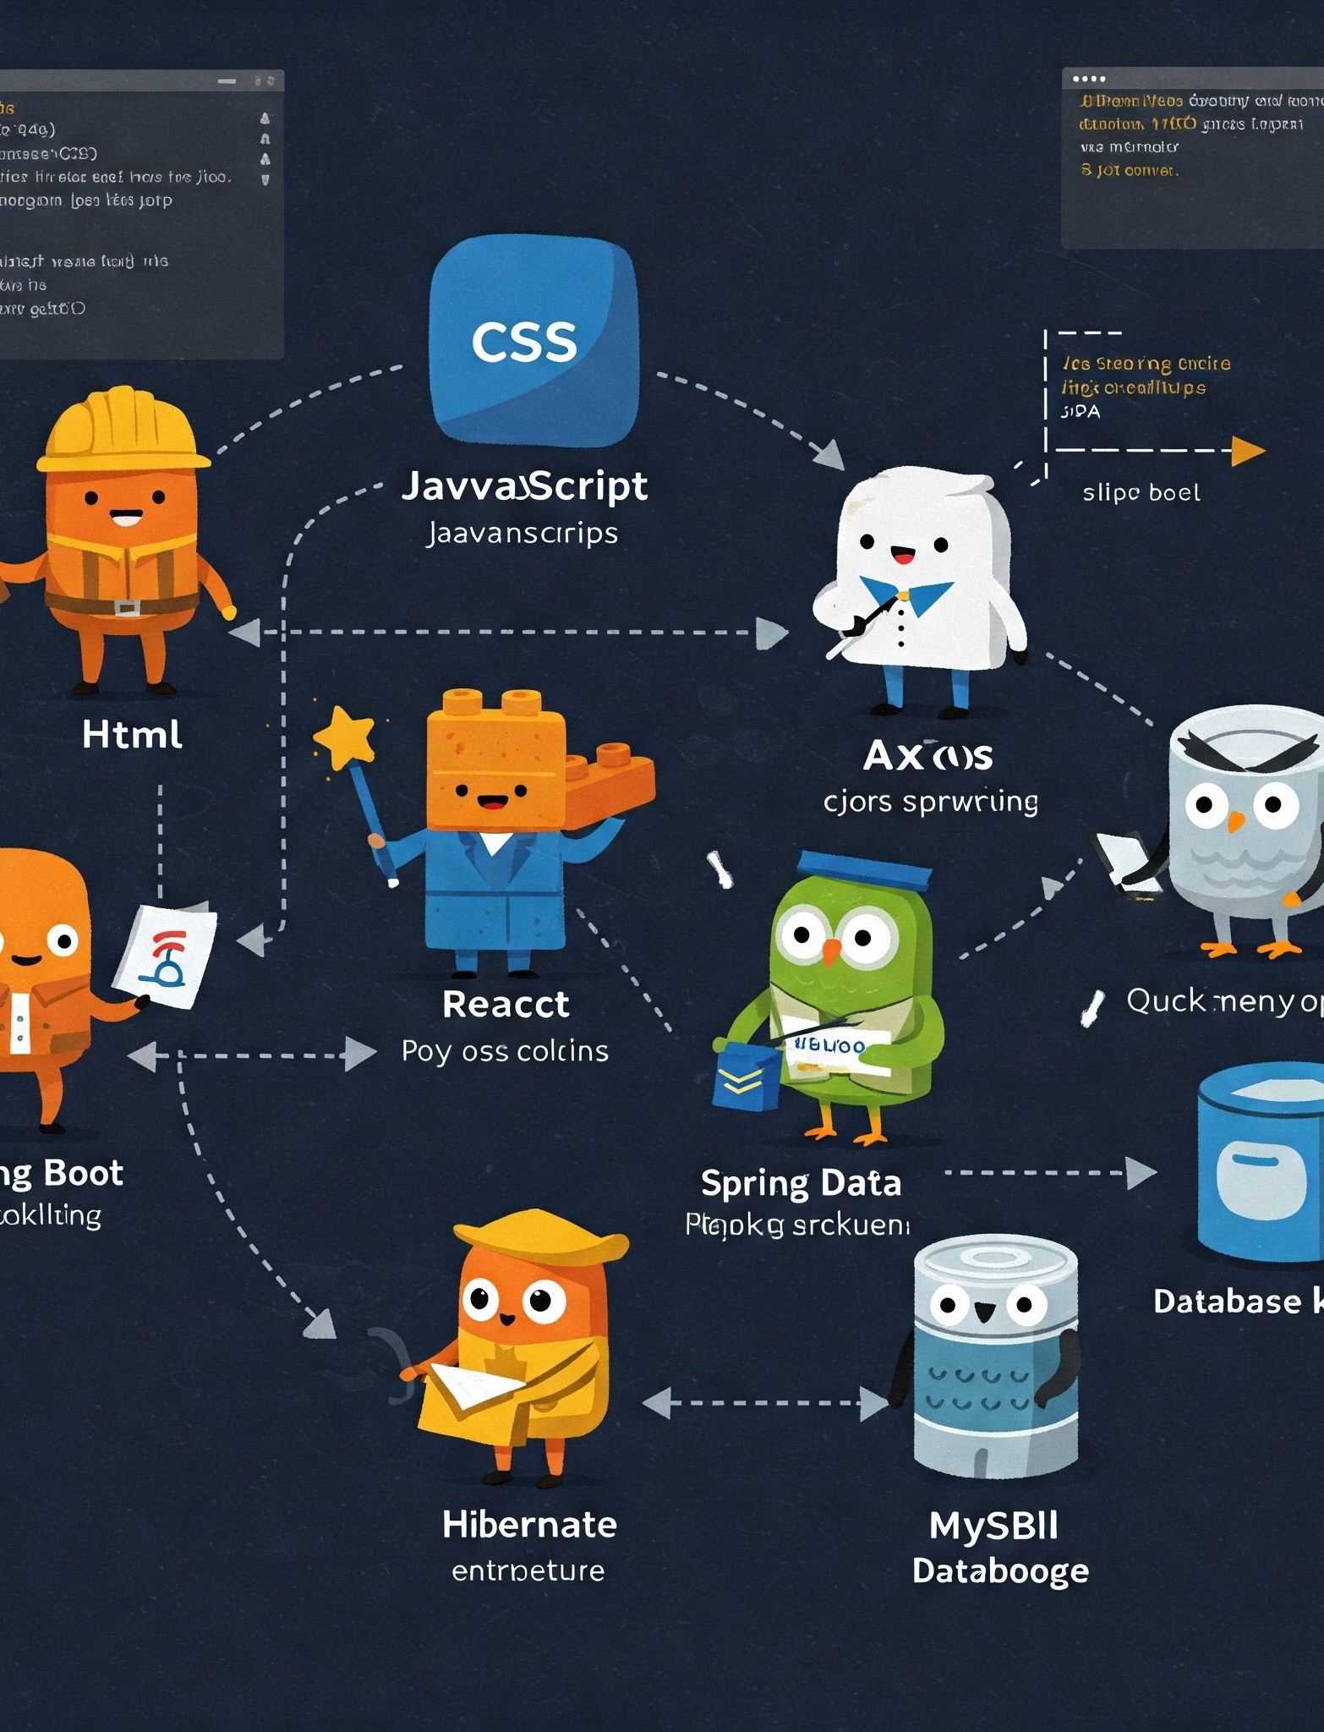
ARCHITECTURE
Front-End :
HTML
CSS
Javascript
React
Axios
Back-End :
Spring Boot
Spring Data JPA
Hibernate
database :
Mysql

Slide 5
Reason for selecting the specific technology
React :- It allows developers to create large web applications that can change data, without reloading the page. The main purpose of React is to be fast, scalable, and simple. It works only on user interfaces in the application.
Spring Boot :- It provides a flexible way to configure Java Beans, XML configurations, and Database Transactions. It provides a powerful batch processing and manages REST endpoints. In Spring Boot, everything is auto configured; no manual configurations are needed.

Slide 6
USER ROLES AND RESPONSIBILITIES
Agri-Mart consists of three roles described as below :
Admin
Manage users (customers and farmers).
User
Browse and purchase fresh produce.
Oversee product listing and marketplace operation
Handle transactions and resolve disputes.
Monitor system performance and security.
Add items to the cart and place orders.
Make payments and receive order confirmations.
Track orders and get doorstep delivery.
Farmer
List and manage farm products.
Update stock availability and pricing.
Process and prepare orders for delivery.
View Earnings and sales report

Slide 7
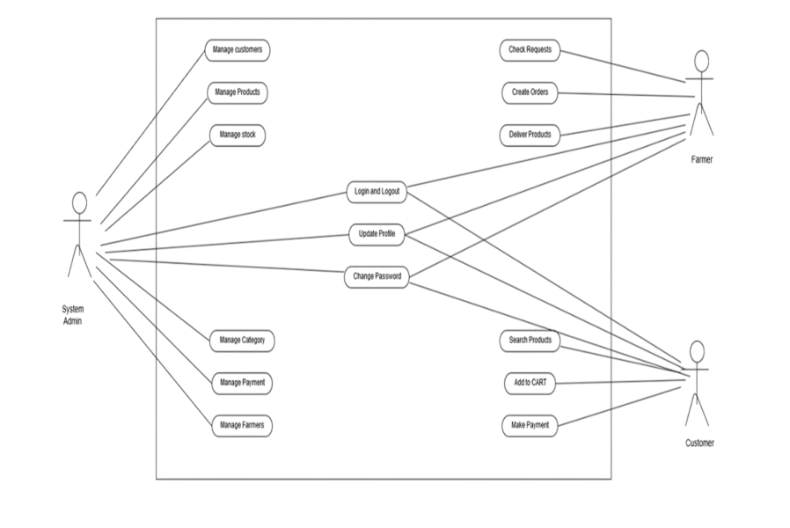
Use-Case Diagram for Each User

Slide 8
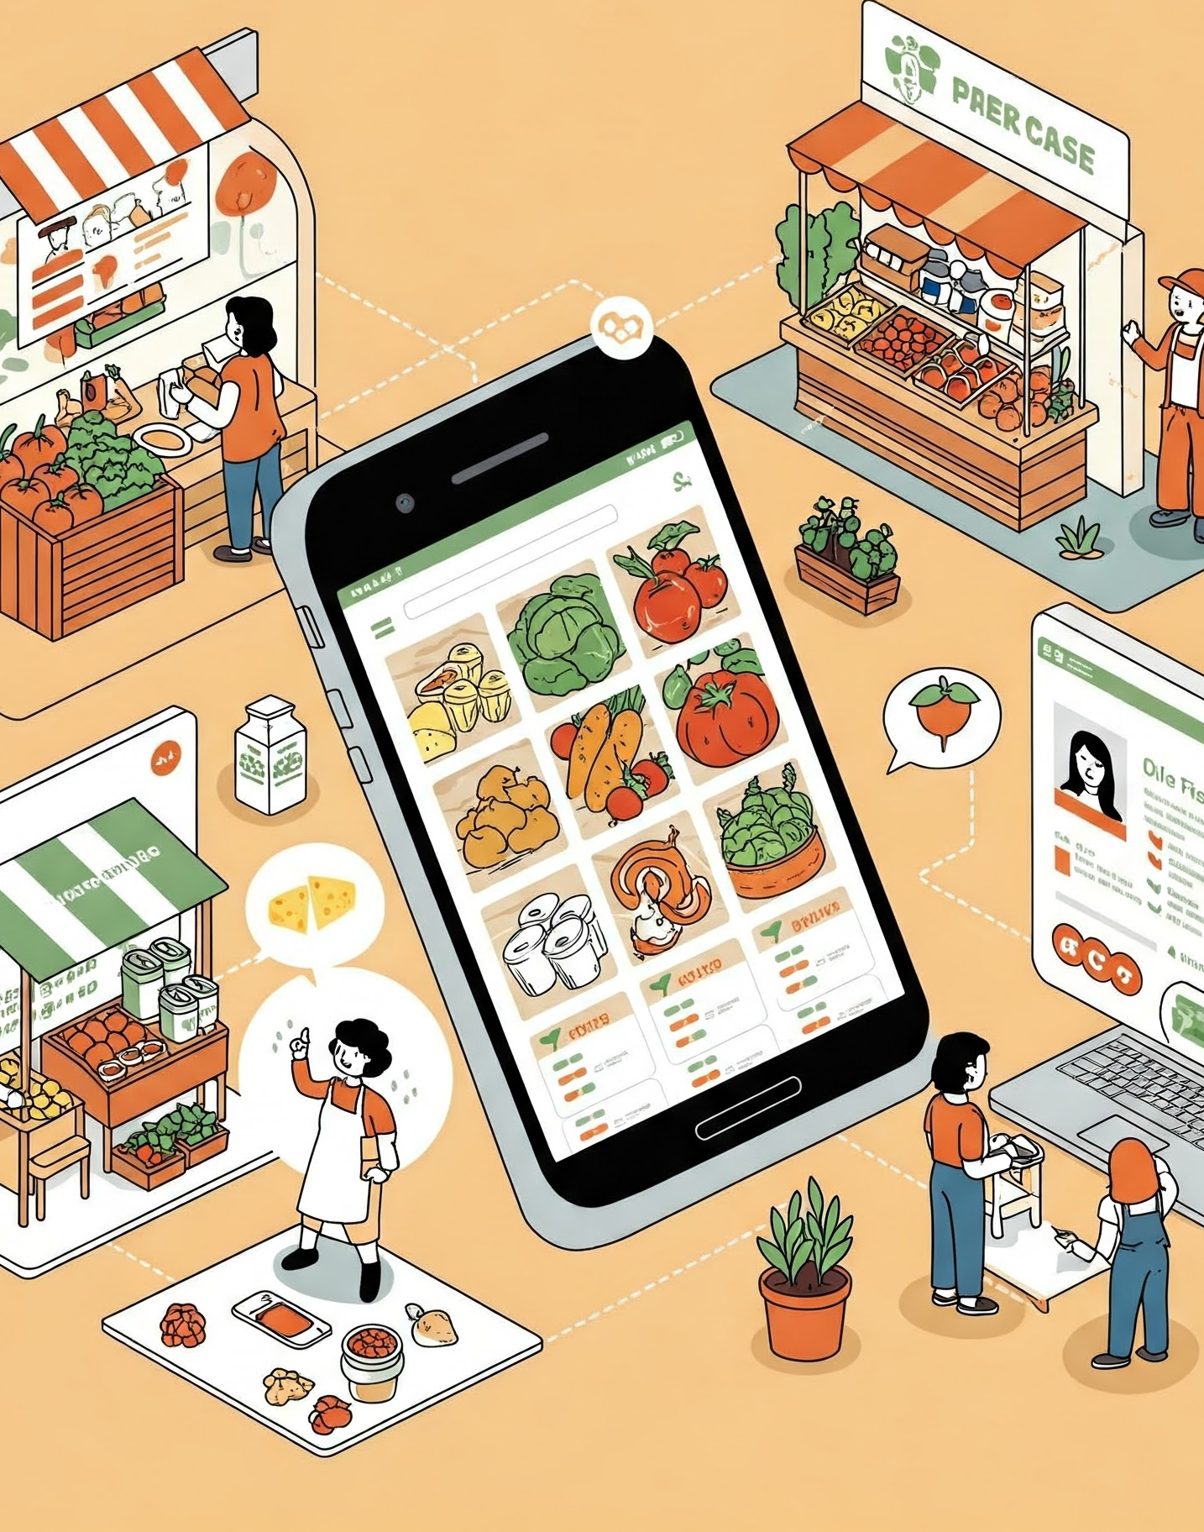
Future Scope
Using whatever we have learnt over the duration of this course, we tried to make our project as user-friendly and gave it as many features as possible in the limited time allotted for the project work. That said, there are certainly more features that can be added to our application. Some of those are mentioned below:
The most purchased and/or sponsored products can be highlighted as customer favorites to promote merchandise further.
Rating chart for Farmers and Products.
Product Display based on Categories, distributing Farmers and respective ratings.
Discounts can be given on a per-user basis depending on the customer’s purchase history as well as how many products they buy at the same time.
Customers can upvote/downvote/report feedbacks.
Additional payment means can be added other than cards.
In case the user forgets the password, a ‘reset password’ functionality can be added.
CAPTCHA can be added to login page.

Slide 9
Conclusion
The Agri-Mart is a cost-effective, user-friendly online grocery platform connecting farmers and customers. Built with open-source, cross-platform technologies, it ensures a seamless shopping experience. This application empowers farmers to enter the online market while providing customers with a one-stop solution for fresh, organic produce.

Slide 10
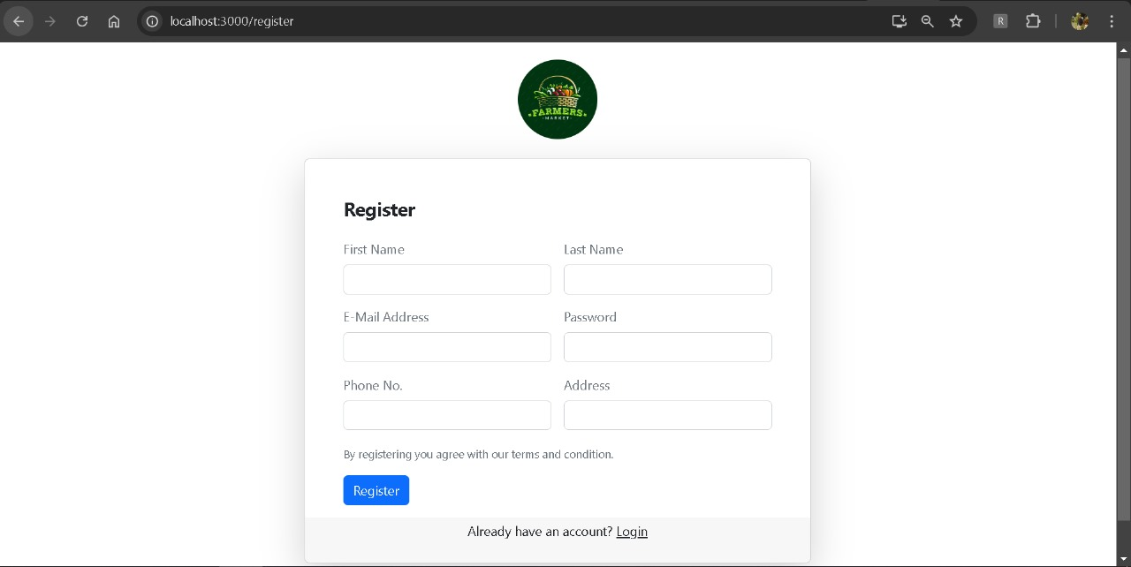
User Registration

Slide 11
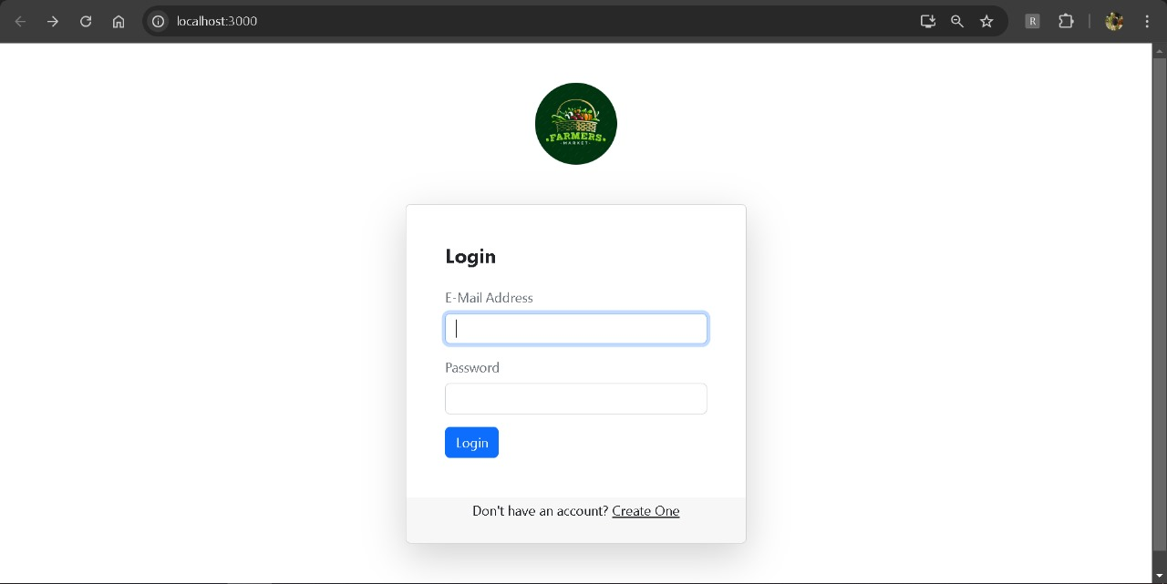
User Login

Slide 12
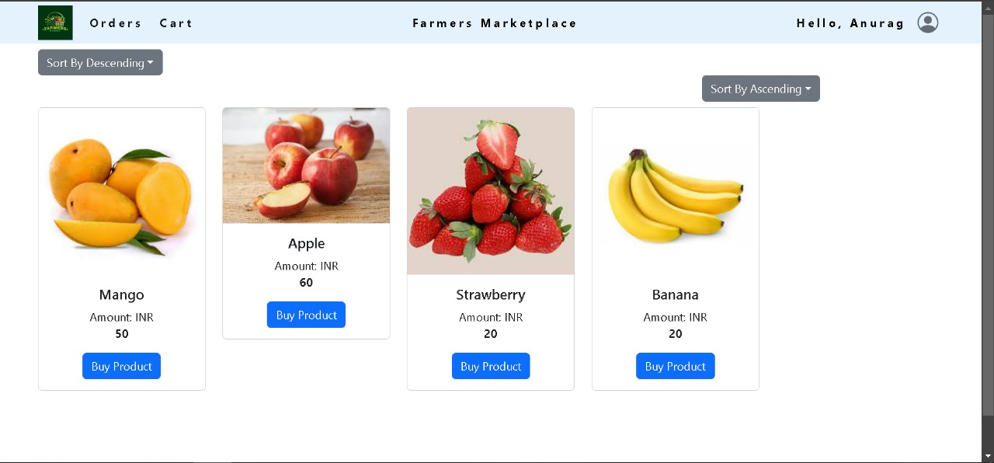
Homepage

Slide 13
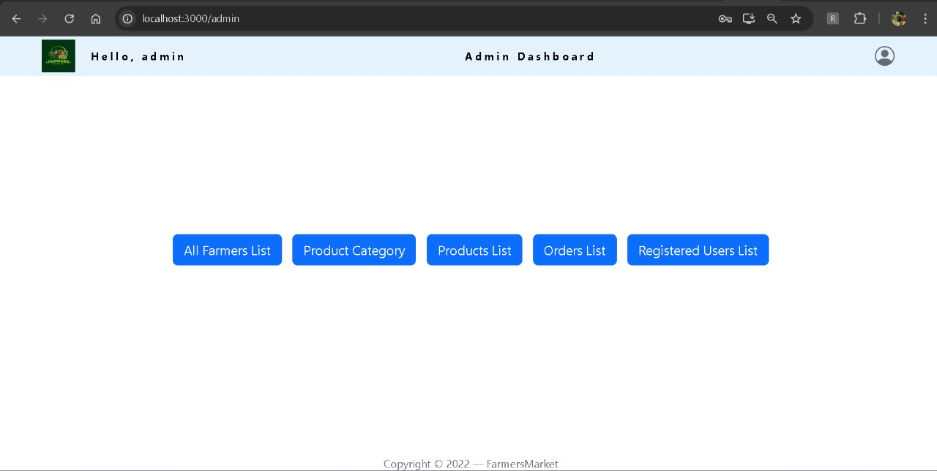
Admin Dashboard

Slide 14
Thank you !

